Slide 1
Globetrottr - Travel App
Team 3

Slide 2
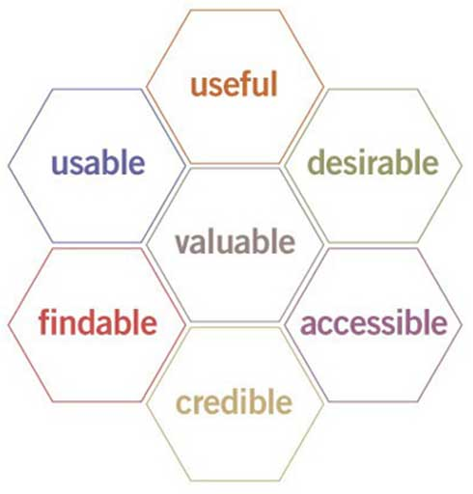

Slide 3
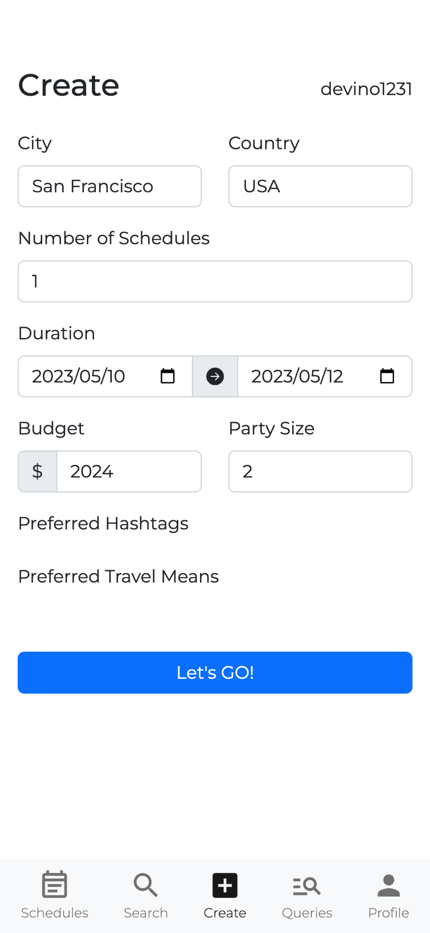
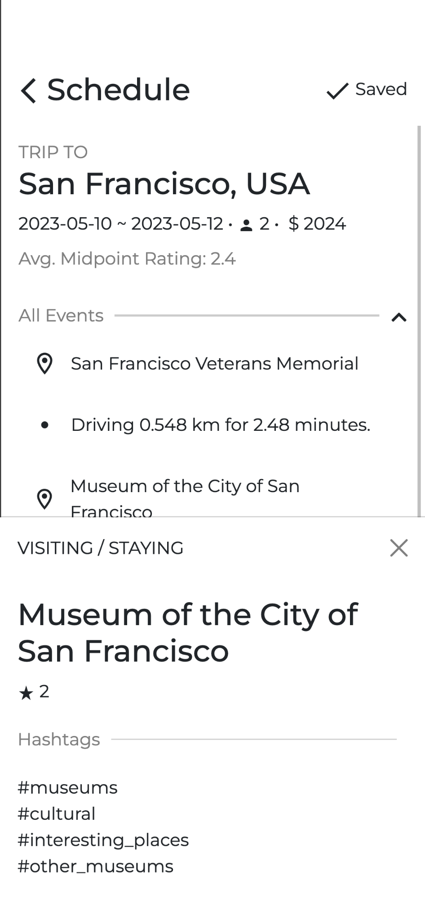
UI/UX: Useful
Globetrottr is a unique travel app that generates customized schedules for user to see and add to their collection.
It has its own kind of schedule generator and schedule viewer.
Notes:
useful, usable, findable, credible, desirable, accessible

Slide 4
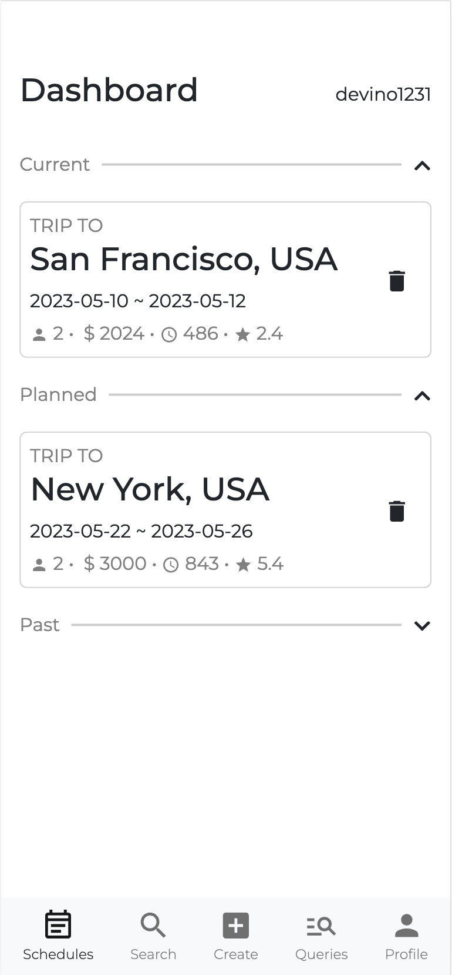
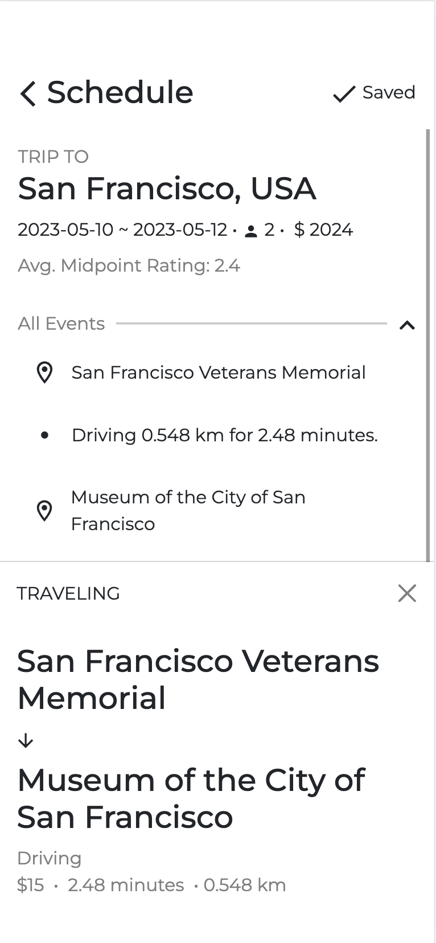
UI/UX: Usable
Minimized clutter
Collapsible sections allow user to hide unwanted information.
Easy single-hand access
The navbar, the portal to all major sections of the app, is placed at the bottom of the screen for easy access.
The save button was put at the top right corner to limit accidental trigger while being accessible with the thumb.
Event detail window placed at the bottom so it can be easily closed.
Notes:
As a mobile app, we designed the UI to be clean, with minimized clutter to efficiently convey information in a small screen. One example is that we have this collapsible section that allows users to hide unwanted information

Slide 5
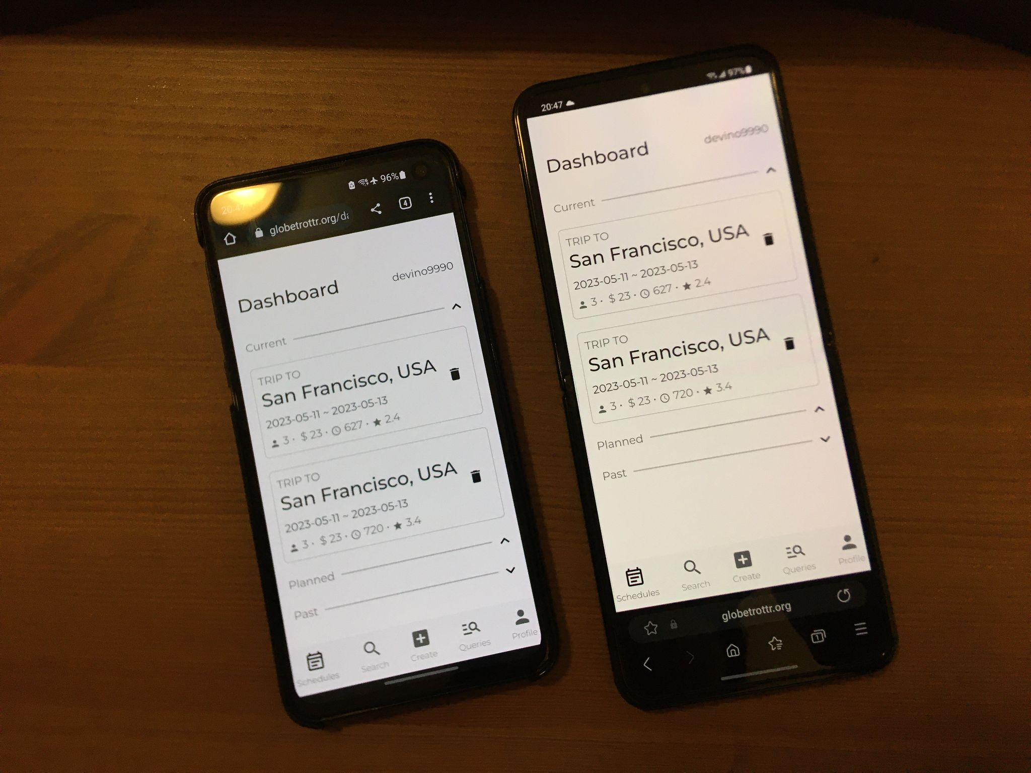
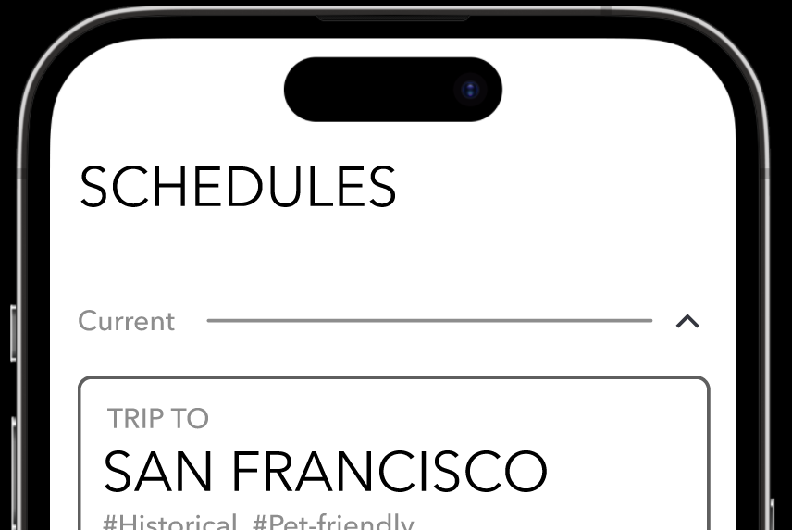
UI/UX: Usable
Easy single-hand access
The title bar was deliberately made thicker and lowered.
Not only for accommodating the notches/punchholes of modern mobile phones, but also made it slightly easier to reach items at the top of the screen.

Slide 6
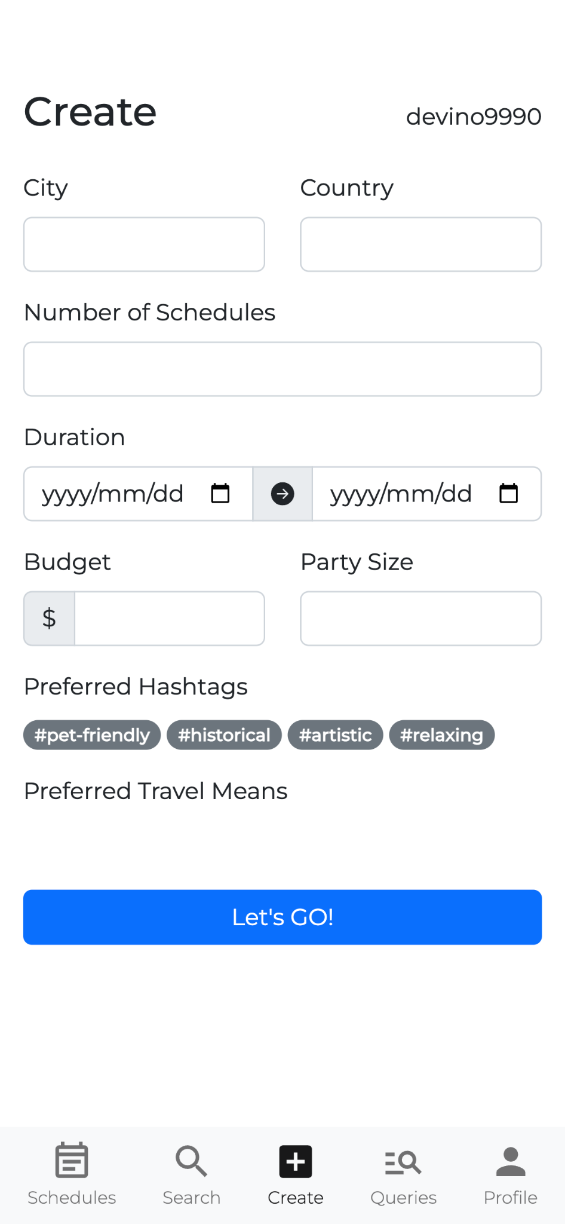
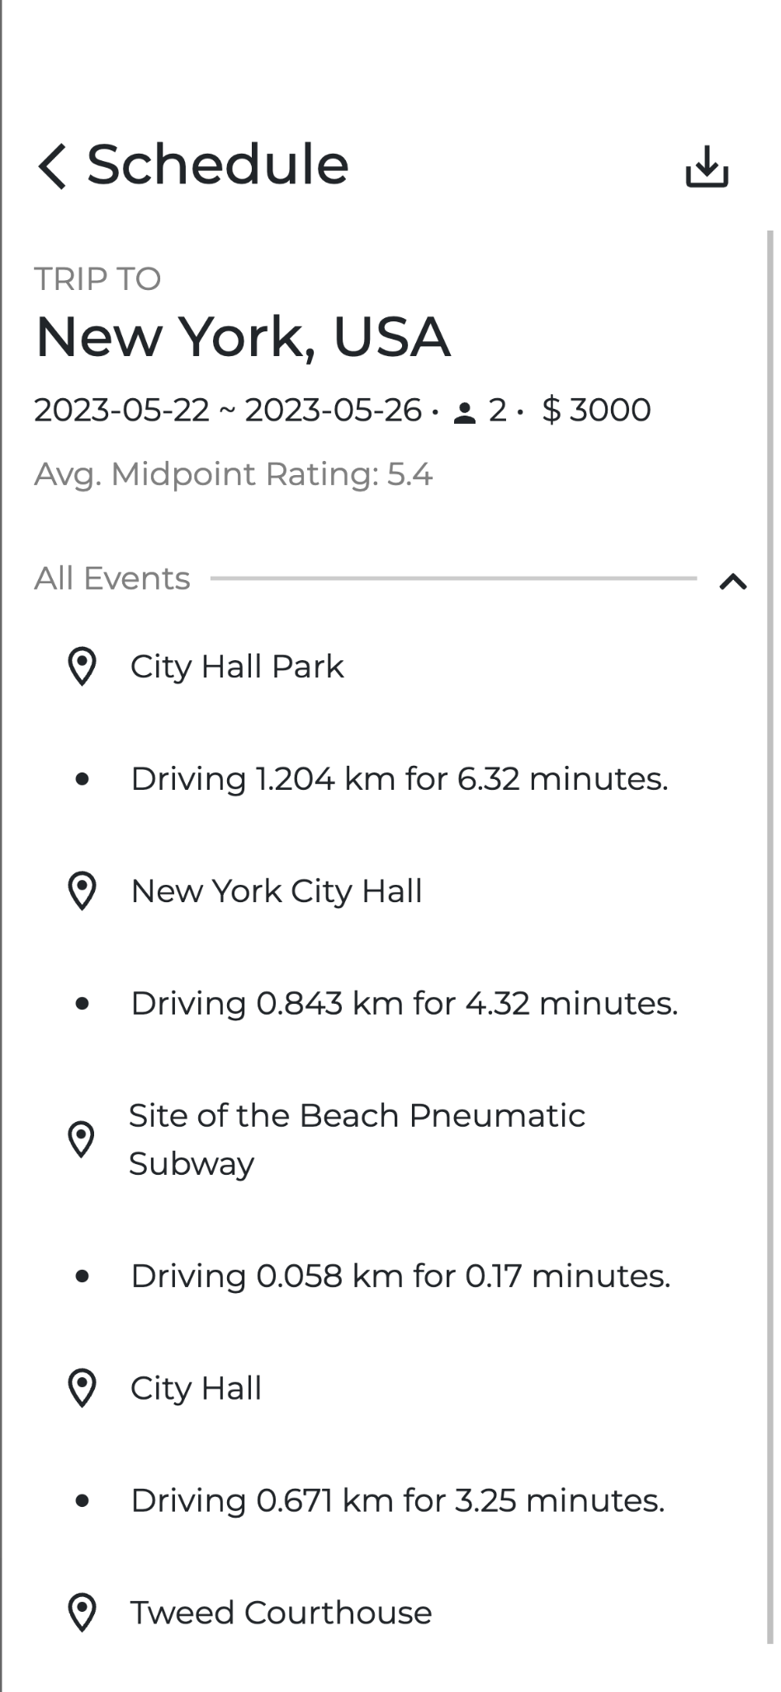
UI/UX: Findable
Findable
Major functions are easily locatable in the bottom navbar.
The ordering is specifically designed, with the main function - schedule generation - being at the middle of the navbar for easy location.
Functions are accompanied with icons to be more recognizable.
Functions we consider what the user would mostly perform would be put at visible location (i.e. save button)

Slide 7
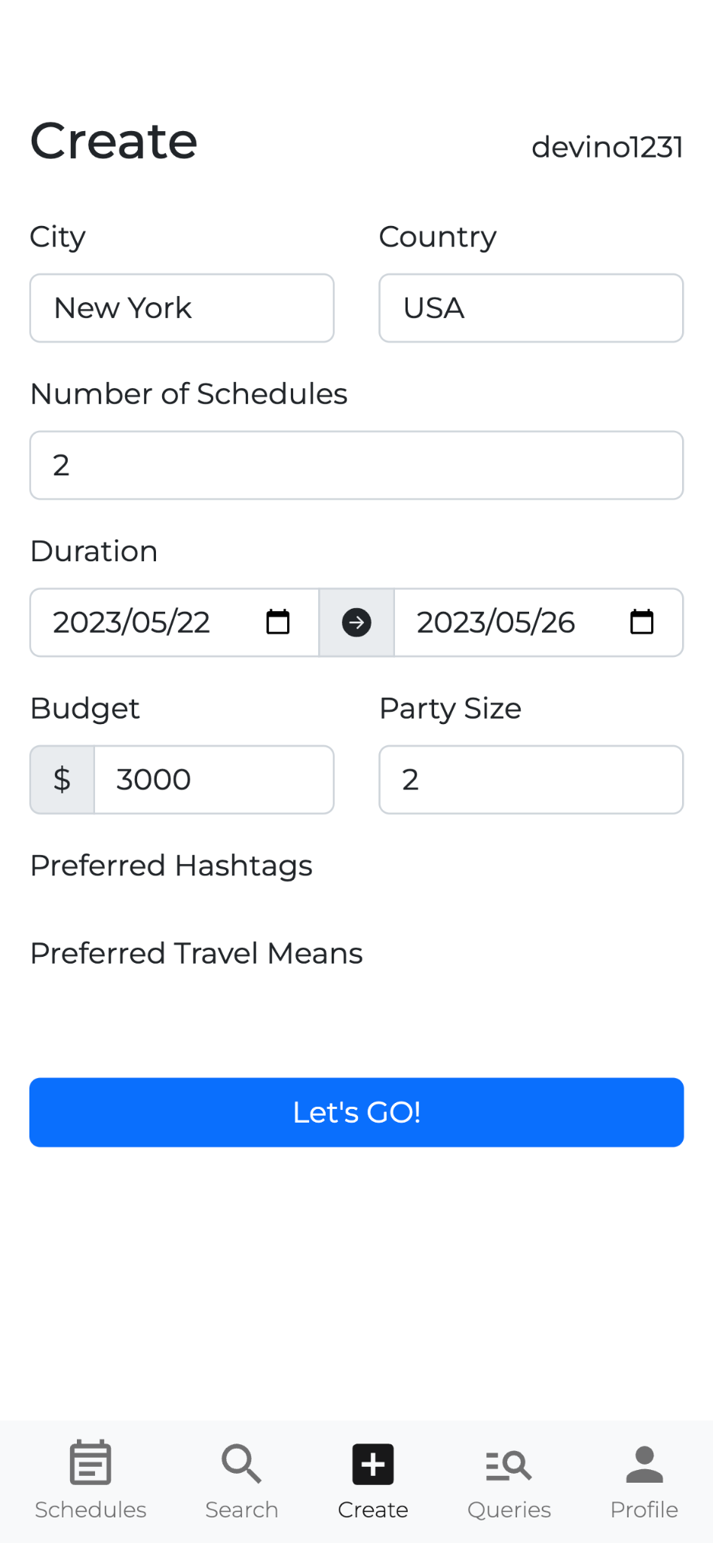
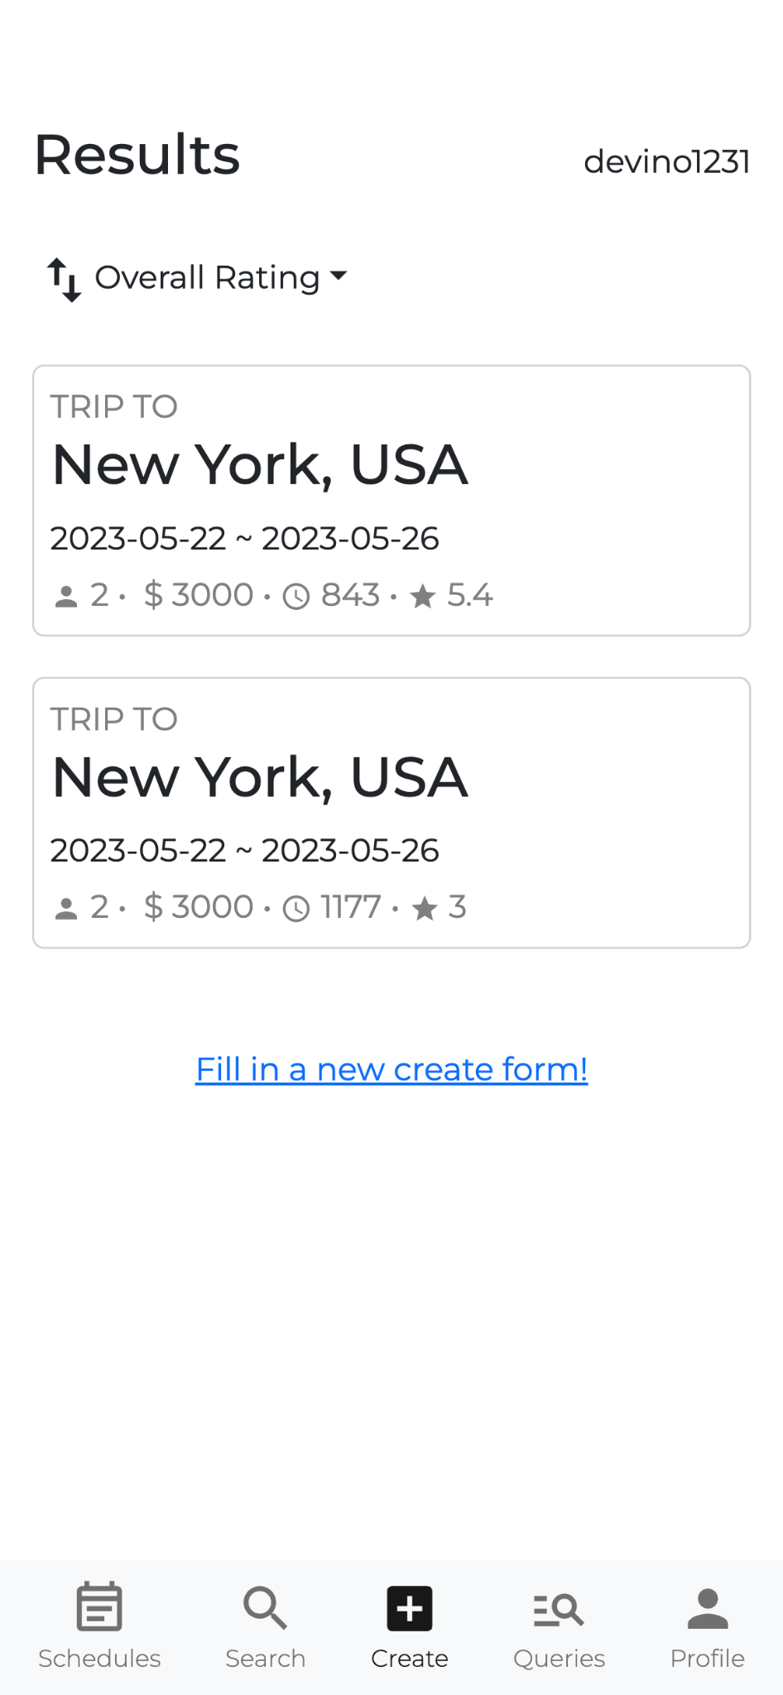
UI/UX: Findable
Findable
Most functions can be accessed in 1~3 layers of screens
The deepest one is to save the generated schedule, but with only 3 layers (create form - schedule preview (results) - schedule details)

Slide 8
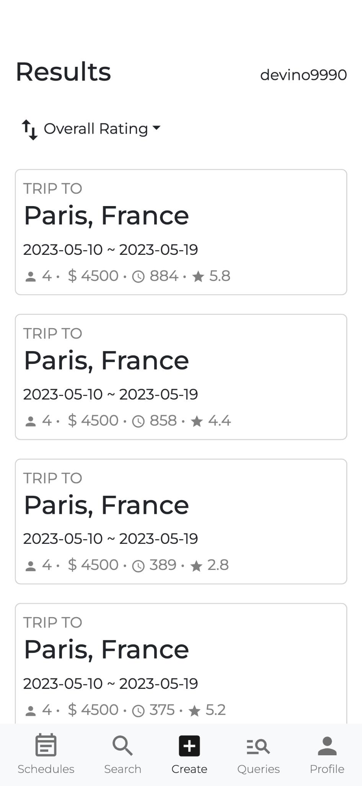
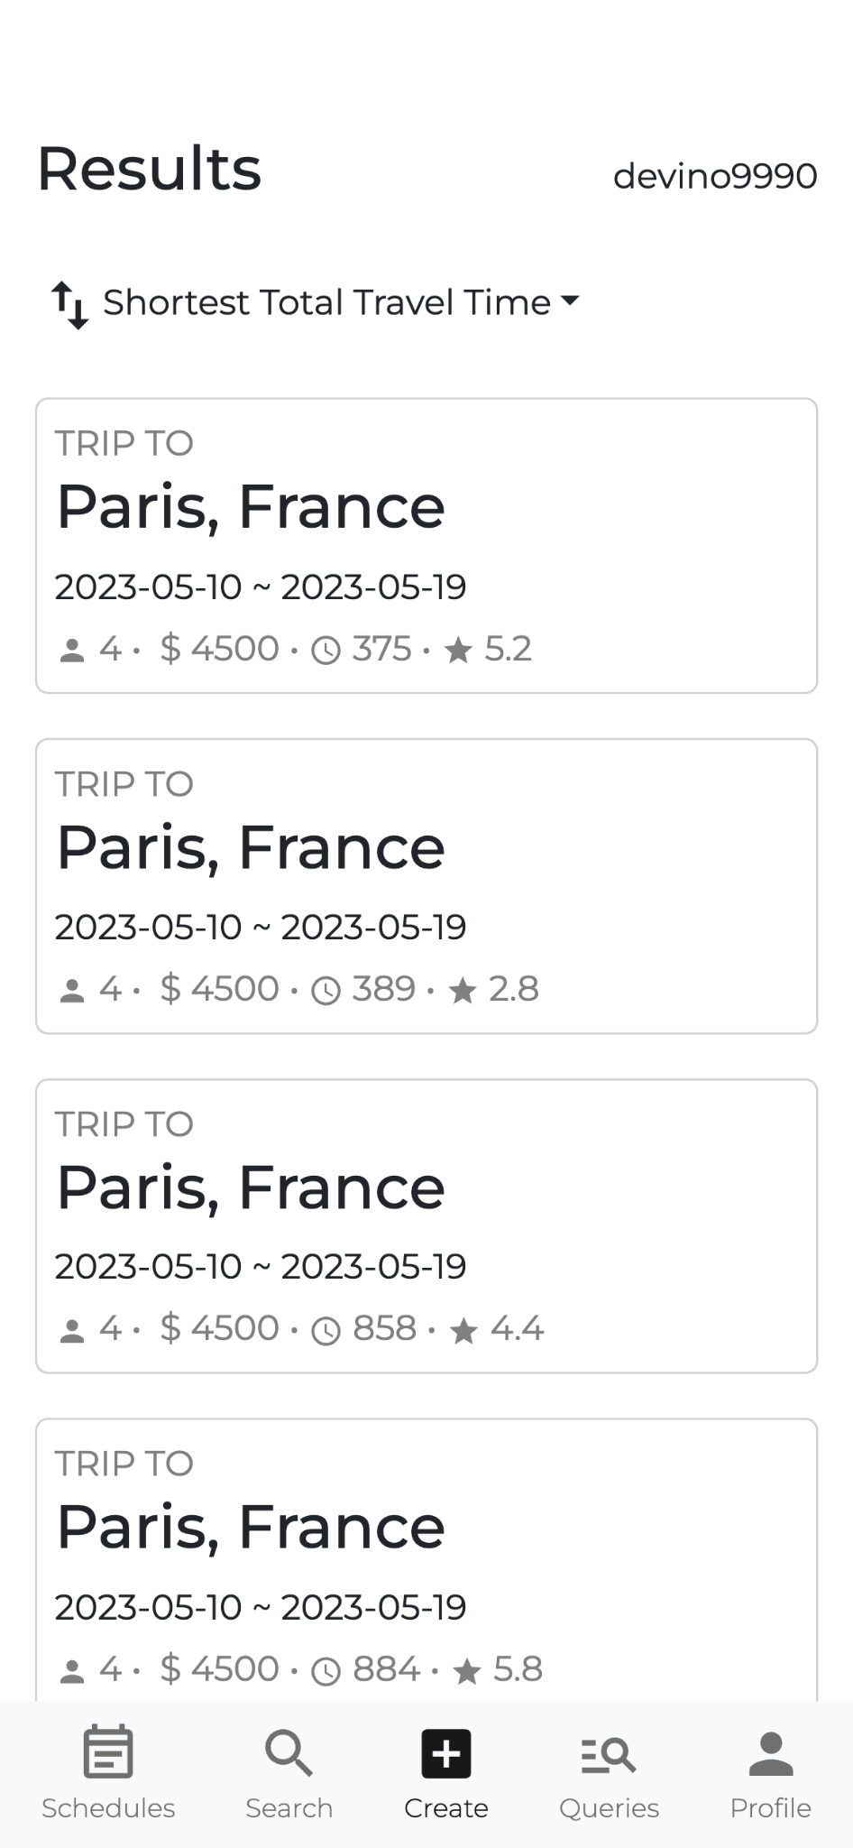
UI/UX: Credible
Credible
The generated results can be sorted by various criterias. The user can be sure that they get what they want at the top of the results list.
This makes the results more trustworthy to the users.

Slide 9
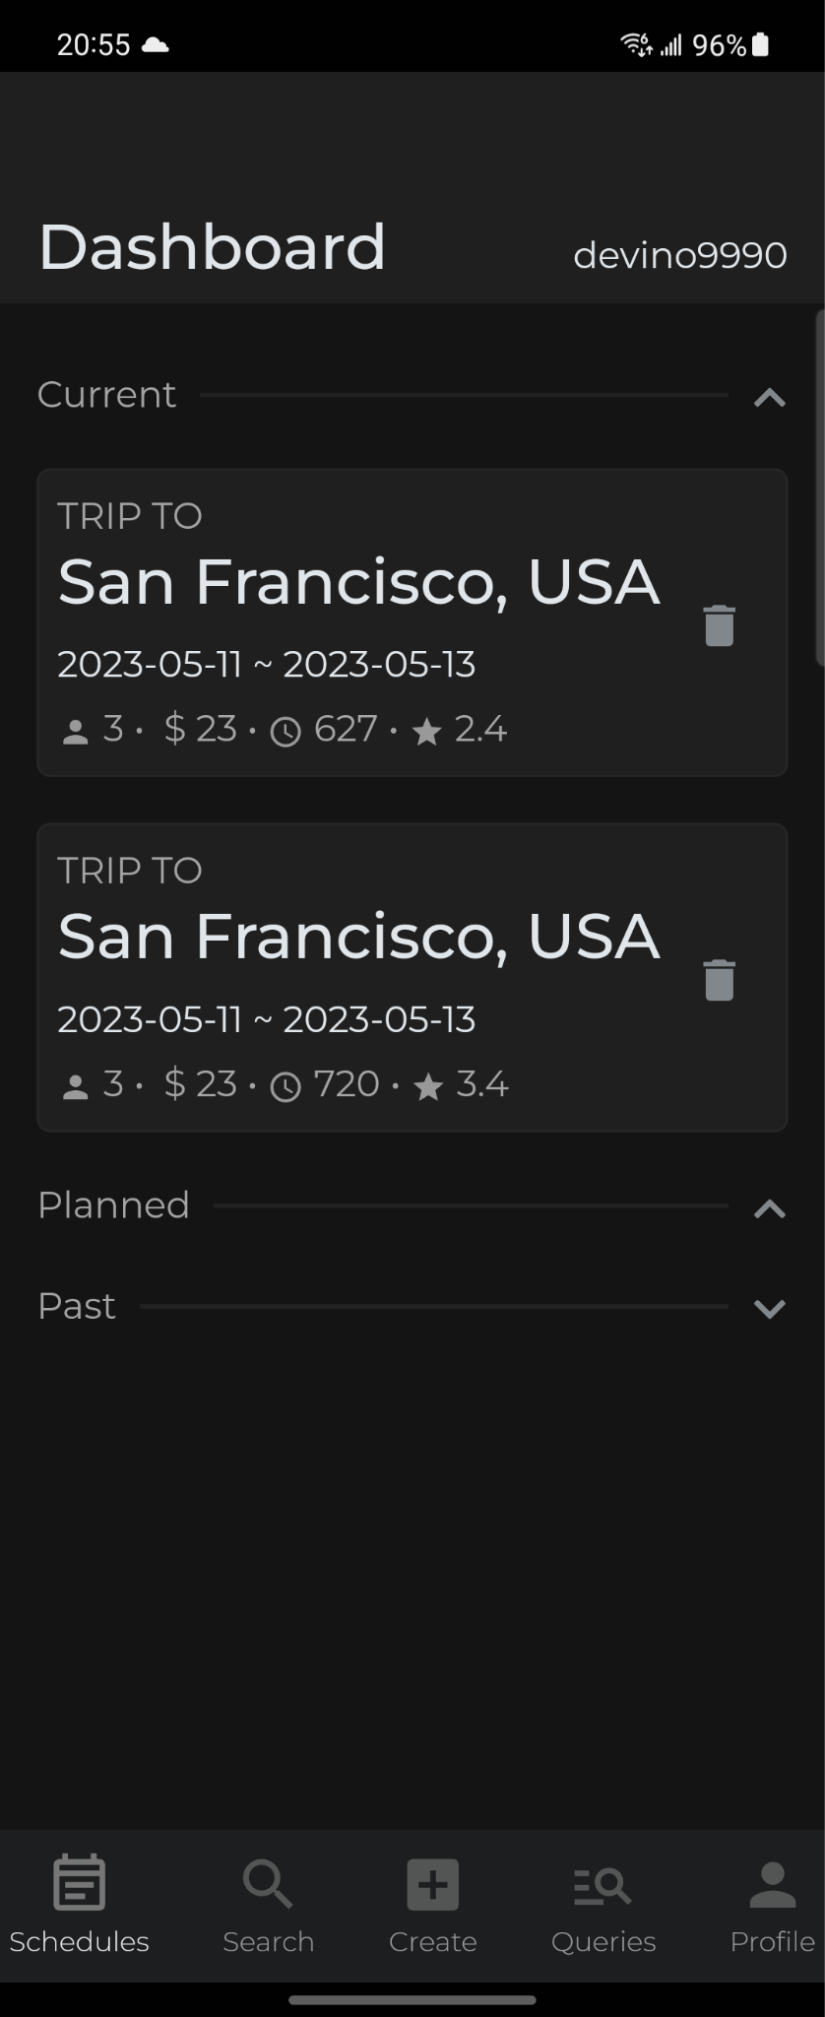
UI/UX: Desirable & Accessible
Desirable
The clean, minimalistic design makes the overall experience enjoyable. It does not overwhelm the user with too much going on at once.
Accessible
Clickable elements and important information were made large for easy location and access.
It’s possible to enable dark mode from the browser settings, so users can comfortably read our site at night.

Slide 10
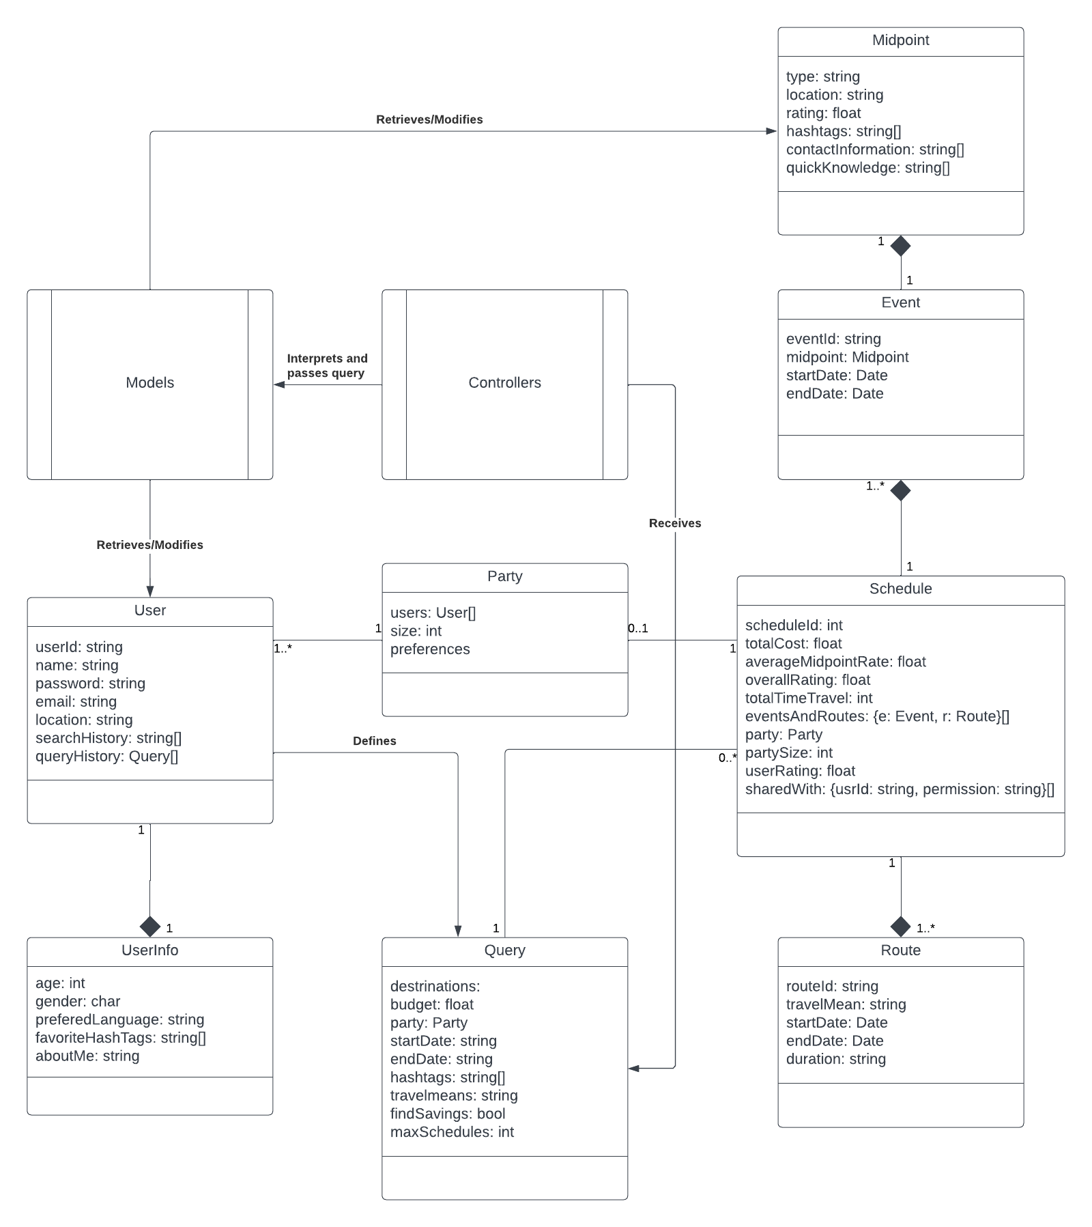
Backend Structure Overview
Early conceptualization
Not perfect
Followed closely throught application development

Slide 11
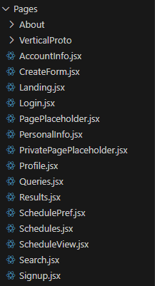
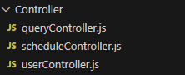
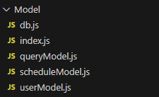
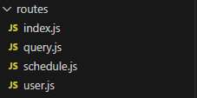
Backend Structure: MVC Architecture
Organized into three different folders:
Model
Controller
Routes
with the Views being stored within the frontend.
Notes:
Each part of the backend is separated within their own folders. Models in the models folder (how the data is formatted). Controllers within the controller folder (all of the functions that interact with our database data/documents),
and Routes within the routes folder (the endpoints that the frontend calls to interact with the database). The views is handled by the frontend side of the application, which contains all of the files/components that the client will see.
Our backend is separated into different folders: the Models folder, Controller folder, and Routes folder, with the Views folder being stored within the frontend side of our application. Models, containing the schema of each document, Controller containing the functions, and routes containing the endpoints. Views, as mentioned before is being handled in the frontend folder, displays what the client will see depending on what they do.

Slide 12
Models
Defines how all the data will be stored into the database (JSON object).
Contains data fields that are expected to be in each document stored in the database.
Formats data based on each Model schema
Easy to edit schema if necessary
Notes:
The models are what makes up how our database stores/sends the data. We have previously defined how the data will be formatted as json objects. Through the use of mongoose, it makes it easier to store this data as mongoose makes the data easily formatable.
This is how the data is stored, but is also how it is being send through each endpoint.
We have three different models, each with their own defined fields. This is how we send/receive data and it will always be formatted this way as a way to stay consistent. These are for their own collections and are very easy to modify in case we decide to include or exclude a specific field within the document.

Slide 13
Views
Stored within the frontend.
Grabs data from the database and uses said data for the client to view.
Contacts the database through the use of endpoints (routes folder) in the backend.
Notes:
As mentioned before, this is all stored within the frontend part of the application. This is what the client sees once they click on the specific pages within our application. After each page is clicked on by the user, the endpoints are called within the route files and stores/displays the data in/from the database.

Slide 14
Controllers
Contains all of the functions that each endpoint (in the routes folder) calls.
Functions use the defined schema within the Models to send/grab data to/from the database.
Ex. queryController includes the queryModel schema. Uses said model to send/receive data from database
Notes:
These files contain all of the functions that each endpoint uses. We have followed the naming scheme of having each model or route correspond with their own specific controller file. Ex. user functions will correlate with the userModel and user files within the model and route folders.

Slide 15
Routes
Each file contains the endpoints that the frontend calls
Endpoints use the functions from within the controller files to communicate with the backend.
Contains HTTP response codes determining what went wrong.
Ex. query -> queryController, etc.
Notes:
The frontend contacts these specific endpoints in each route file. Acts as a gateway to the data within our database. Each endpoint that the frontend interacts with, it goes through the controller files and then the model.
Essentially, the frontend calls these endpoints. These endpoints call functions within the controller files. The controller files grab/stores data from the database that fits the model schema that we have defined.

Slide 16
Notable Endpoints/Functions
/generate
Generates the schedule based on submitted form data
Calls multiple Third-party Apis in order to present the user with schedules
Does not store generated schedules unless user saves
/signup, /login
Handles the creation of users within our database.
Stores created users within the userInfo collection
schedule /add, /remove
Saves a generated schedule into the database and stores it into the user’s saved schedule array
Only stores the schedule’s object id that is automatically generated by the Mongodb database.

Slide 17
Development Practices & Team Building
Branched off of Development
In-depth PRs
Coding Styles
Organized Meetings
Team building

Slide 18
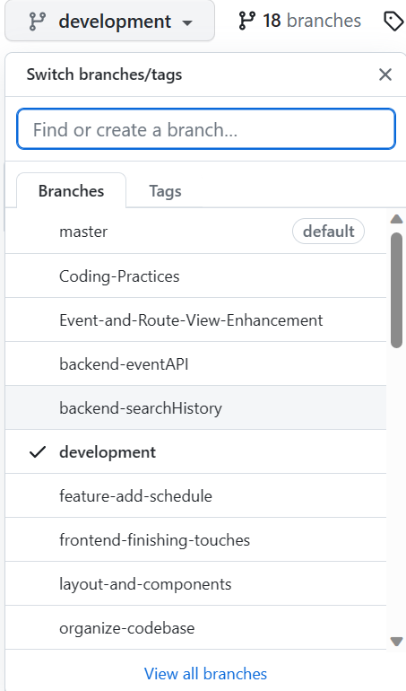
GitHub Branching
We branched off of ‘master’ into ‘development’
Each feature/component of the app had their own branches which branched off of ‘development’
ex) The ‘sort-results’ branch is dedicated to the front-end sorting feature, branched off of development, and when ready, was merged into development

Slide 19
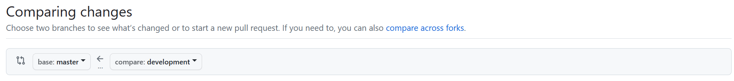
GitHub Branching
At the end of every Milestone, we merged from ‘development’ into ‘master’

Slide 20

In-Depth Pull Requests (PRs)
Every pull request involved detailed comments about what has changed
Every piece of feedback given provided details as to what could be improved, what could be simplified, as well as whether or not coding practices are being involved
No “LoOkS gOoD tO mE”.................. …………………………………………… okay, maybe a little bit…

Slide 21
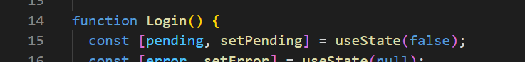

Coding Styles
We enforced the Google JavaScript styling protocol in our files found here:
Google JavaScript Style Guide
If our code broke enforcing the styling principles, we made sure to defy them.
ex) Google requires that function names be camel-case, but certain react functions are required to be in Pascal-case —-------> PascalCaseExample

Slide 22
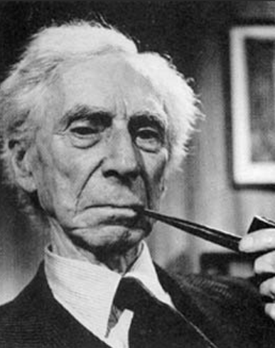
Meetings
We met every Monday during the in-class meeting time and every Friday at 7:30 pm.
In the Monday meetings, we discussed the Milestone next steps, what we need to accomplish by Friday
In the Friday meetings, we discussed what we accomplished since Monday’s meeting and what, if any, work is still needed to be done

Slide 23
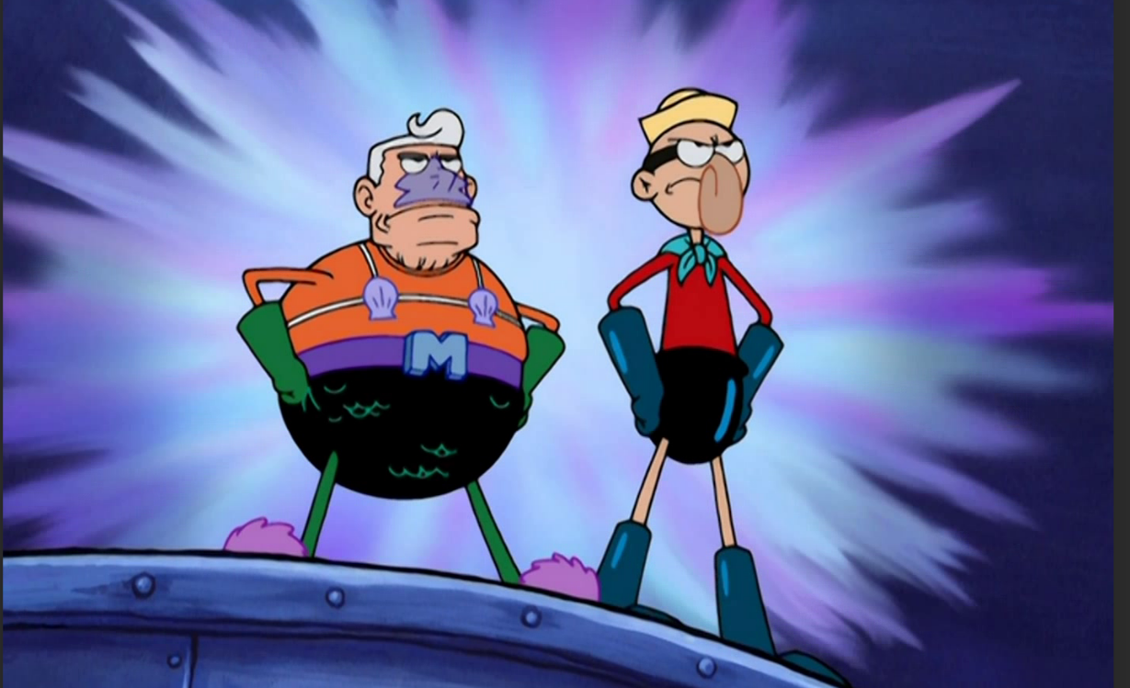
Team Building
We made sure to support each other, help each other, and be very communicative and open about any concerns
We played skribbl.io once and even headed down to the Cesar Chavez Center to play video-games downstairs

Slide 24
THANK YOU

